Slide 1
A Glance at Glance 2.0
By Mandy, Tahiya, Vincent

Slide 2
Requirements
Identifier | Priority | Description
REQ-1 | 3 | Bootstrap MkvIgnite – Bridge data from Marketview to Ignite
REQ-2 | 3 | Understand how to write jobs in the Ignite cluster
REQ-3 | 3 | Understand the requirements that support has for improvements to the Glance UI
REQ-4 | 2 | Have a cluster of nodes setup to partition cache data across
REQ-5 | 1 | Make a thin client that does not change or influence the topological structure of ignite for tasks.
REQ-6 | 2 | Create runnable jobs within Ignite that work on cached data
REQ-7 | 1 | Make a thin client that does not change or influence the topological structure of ignite for tasks.
REQ-8 | 2 | Retrieve data in an SQL inquiry to view cache and manually see data
REQ-9 | 3 | Manipulate data within the cache for checks from anywhere in the cluster
REQ-10 | 2 | Make the clients (thin or not) read only to the data. Exclusive write access only for the server that maintains the Ignite Cache for a specific chain
REQ-11 | 1 | Make search functionality so that users can search for their desired chain and/or record.
REQ-12 | 2 | The system will schedule jobs or tasks to be completed in a user desired fashion
REQ-13 | 2 | Load jobs from a separate database so that integrating with Ignite is not cumbersome
REQ-14 | 2 | The System will allow users to print the cache
REQ-15 | 3 | The system should update the cache when new information is available
REQ-16 | 1 | Data and Metric logging for past analysis
REQ-17 | 3 | Horizontal scalability (ability to seamlessly add hardware and server to accompany growth of data and service.
REQ-18 | 1 | The system should manage the load across the cluster and prioritize certain jobs
REQ-19 | 2 | The system will subscribe to all market view data available and distribute it among other servers in the cluster
REQ-19 | 3 | The system will be able to recover from random node disconnections and crashes within the cluster

Slide 3
Functionality
Main features:
A service to run Marketview checks on
A service that caches Marketview data to make it more easily and readily available
Cluster computing limiting client computation and client cache access
Easier and abstracted cache access
An interactive UI that helps the user understand the data presented to them
Fetch specific chains and records asked by the user
Data logging and metric logging for performance management

Slide 4
Usability
Showing failures directly on Home for simplicity
Validation through SSO account
Written check scripts remain in glance but computation moved to ignite for efficiency

Slide 5
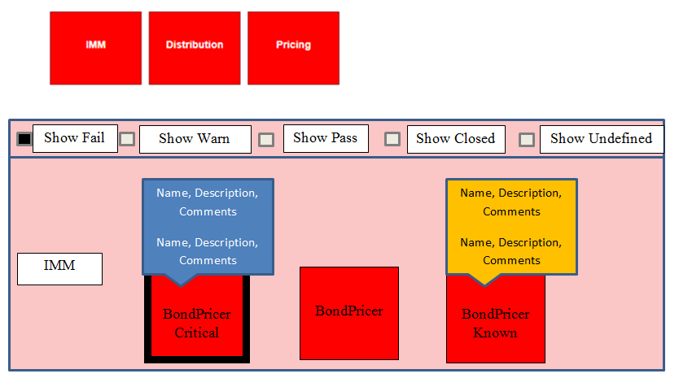
On-Screen Appearance
Home Page

Slide 6
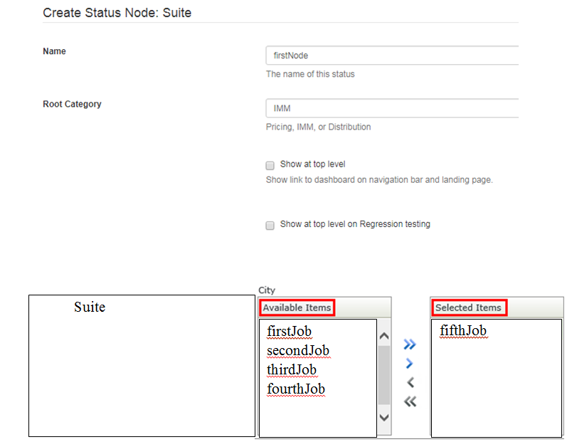
On-Screen Appearance
Dashboard – Adding new node

Slide 7
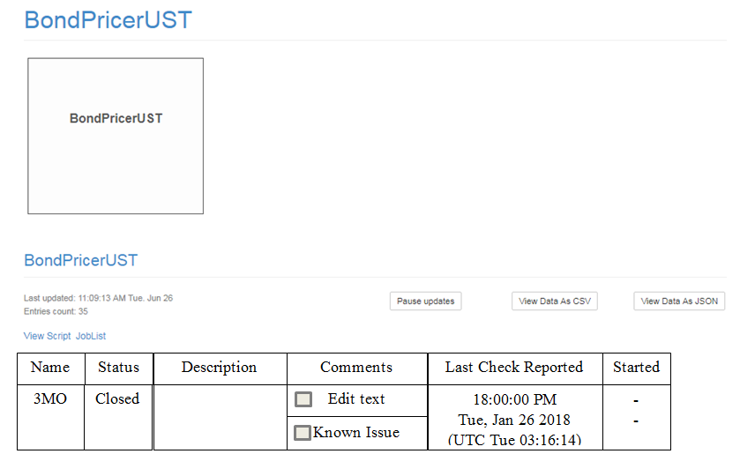
On-Screen Appearance
Suite Node – showing entry level information

Slide 8
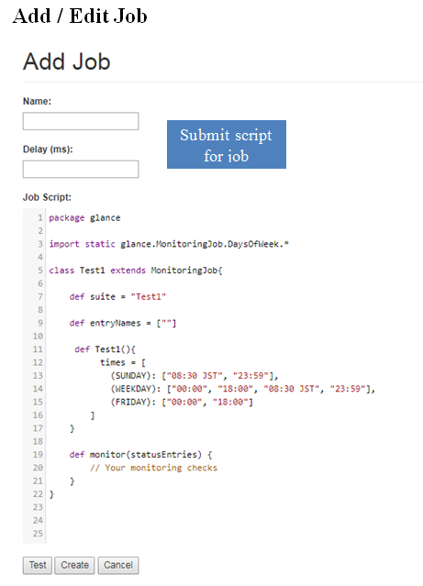
On-Screen Appearance
Add new job

Slide 9
Reliability
Availability :
When a system terminates it can be restarted with the cached backed up across multiple different nodes.
Accuracy :
The accuracy of the Ignite data will be at the mercy of three factors, the network connections with MKV, node cache speed, and MKV itself.
Recoverability :
As long a single server exists, node can connect and reconnect/sync to MKV and continue operating.

Slide 10
Performance
Speed:
Server nodes may take a few seconds to boot up, connect and sync with Marketview and other nodes.
Client nodes should be relatively quick with startup considering they do not create caches or clusters.
Efficiency:
Ignite will pool available threads and distribute tasks in a multi-threaded fashion keeping track of distributed deadlocks and live locks; with optimization, load sharing and throttling will be available in order to increase throughput.
Resource Consumption :
The amount of RAM and disk space utilized depends on the amount of information retrieved from MKV.
CPU computation is dependent on the task run within the cluster.
Scalability:
Servers can be added to accommodate for additional resources.

Slide 11
Serviceability
Repair Speed :
Can always revert back to a state where the client/server worked using Bit Bucket
Install ability:
Since the users are accessing the information via web servers
Deploying the RPM’s on machines will handle the installation and connection between cluster nodes
Testability:
Can easily test how servers handle data load by using Marketview data or simulating heavy client usage.
Logs and metrics to detect runtime operation errors
Force topology adjustment by creating multiple servers and clients.
Configurability:
Our code is configurable since it relies on the apache ignite cluster model where node are continually dropping and joining.

Slide 12
On-Screen Appearance Requirements

Slide 13
Use Case

Slide 14
Use Case 3 Full Description
UC-3: Check Status:
Users who are on glance click on the job the category their check can be found under
Glance updates and the user repeats step 1 until the desired check is reached.
The user will then be able to see if the check is green(pass) or red(fail)

Slide 15
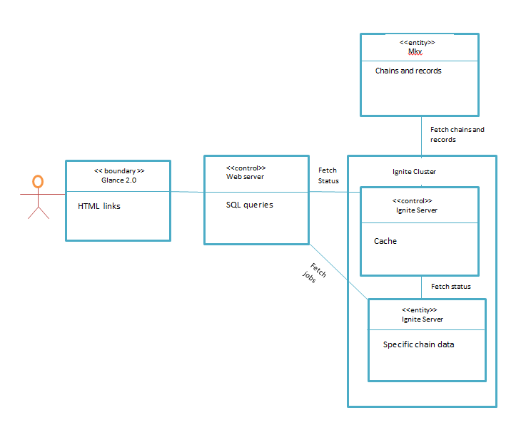
UC-3: Checking Status

Slide 16
Use Case 5 Full Description
UC-5: Information Access:
User requests a specific chain or job using the Glance UI
User starts to type name of the Job or chain into the Glance UI
User selects the chain or job they wish to view
After selecting a chain the Glance UI will update with a list of records
User will select a record
After selecting the user will be able to view the contents of that record
After viewing the specific chain the user can repeat number 3-6 to access another chain or record
After selecting a job the use can specifically view the outcome of that job. Additionally all job statuses will be broadcast to the glance web server.

Slide 17
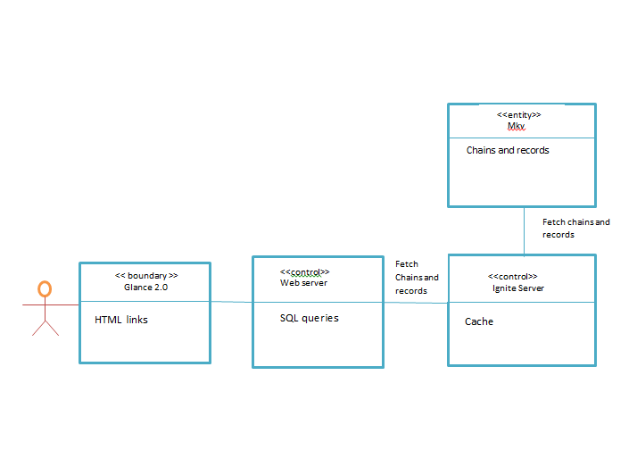
UC-5: Access chains, records, and checking jobs statuses

Slide 18
Use Case 8 Full Description
UC-8: Scaling:
User wants to change the node topology
User adds a server to the topology using the given RPM
The server connects and subscribes to any chains that are not subscribed to
The server joins the cluster and begins caching/computing
User removes a server they shut down the machine or node.
The topology shifts and upon removal nodes will subscribe to the downed servers information.
If the user adds or removes clients only the topology will change and not the computation or the cache

Slide 19
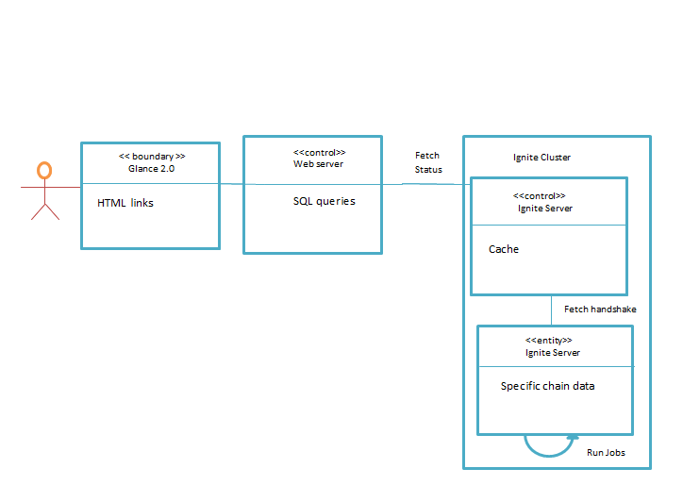
UC-8: Scaling

Slide 20
System Architecture and System Design
We are going to use a three tier system.
UI, Logic, and Data portions of our project.
This approach incorporates the use of multiple platforms for development.

Slide 21
System Architecture and System Design
Presentation Tier: This tier represents the UI of the system, including web layout, information display, and check notifications.
Logic Tier: This tier pulls information from the database and does most of the computing and heavy lifting of the program. Mainly, this tier will focus on the calculation of checks, the management of cache, user connections and changes in topology.
Data Tier: Data consists of chains, records, jobs, metrics, and job statuses. Users should not be able to directly access this information without going through the logic tier.

Slide 22
